Slide 1
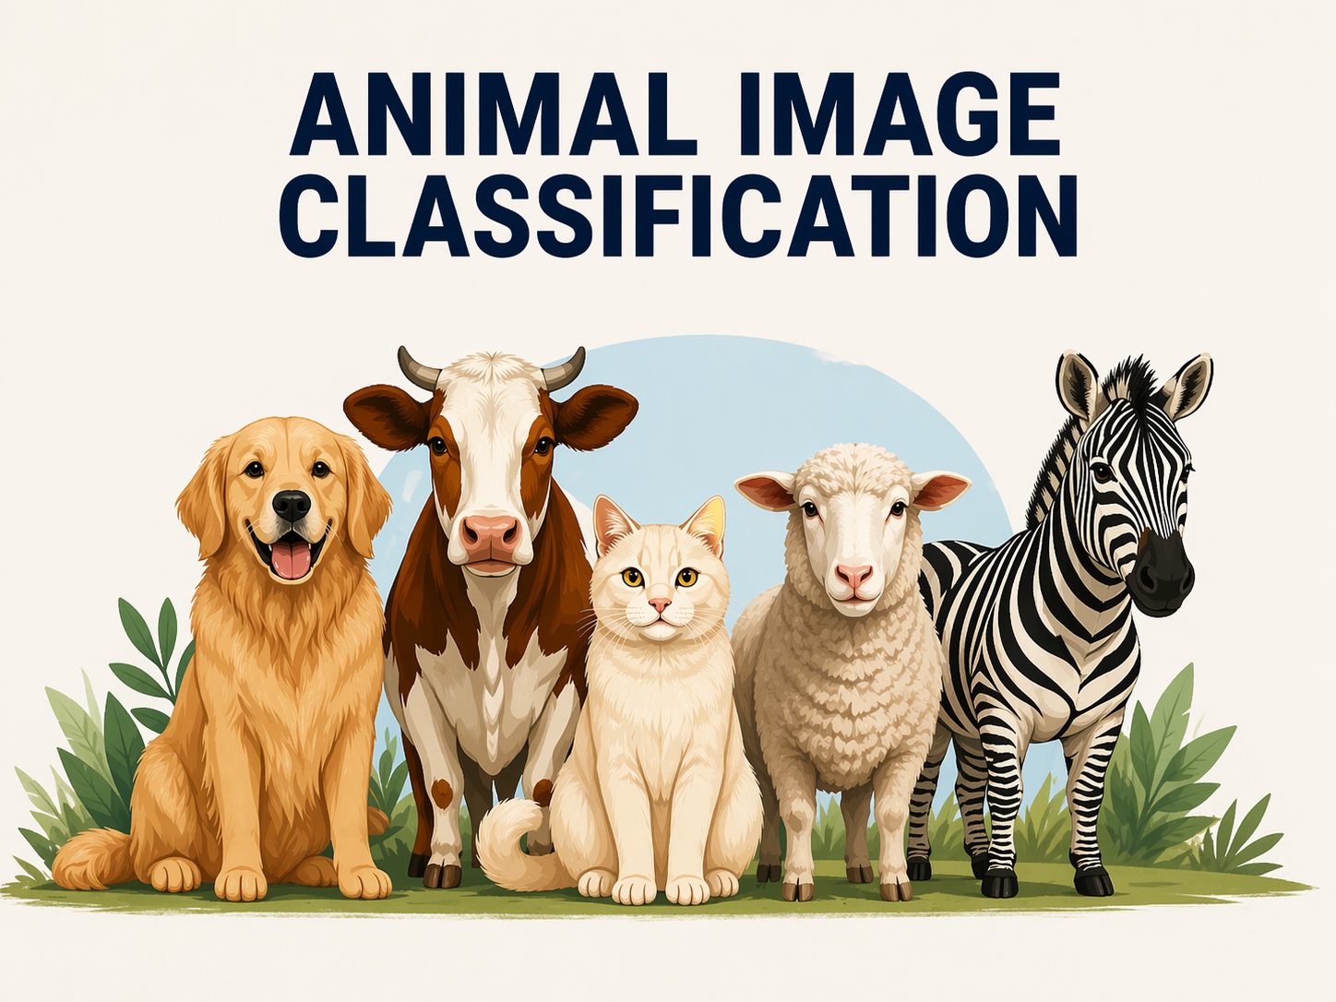

Slide 2
Group members
Shahriar Swanon (2231540642)
Md. Abu Sufian Protik (2312234042)
Khandakar Atikur Ahsan (2222120642)
Md. Faiaz Bin Hayder (2222629042)

Slide 3
Dataset
Cat – 111 images
Cow – 101 images
Dog – 105 images
Lamb – 107 images
Zebra – 108 images
Total – 532 images

Slide 4
Models
SVM
Logistic regression
Random forest
KNN

Slide 5
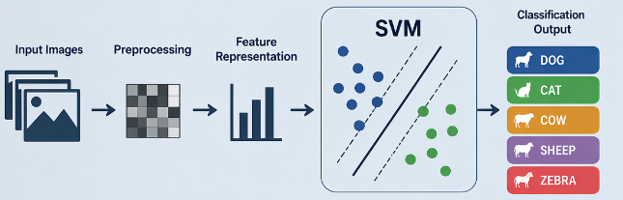
Support vector machine (SVM)
We used SVM because it performs well on small datasets and high dimensional data.
It can model non-linear decision boundaries using kernel functions.
HOG feature extraction was used to provide meaningful input features for the model.
However, due to limited dataset size, the model shows overfitting and the model achieved around 59% test accuracy.

Slide 6
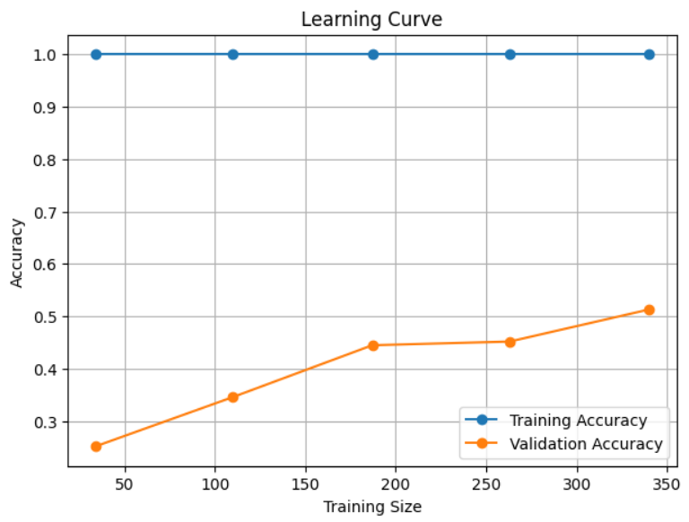
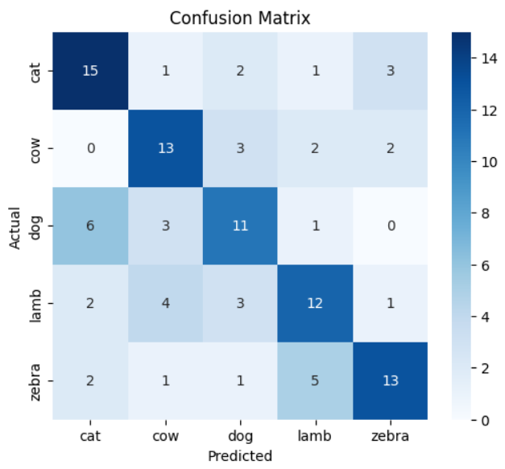
Learning curve and Confusion Matrix

Slide 7
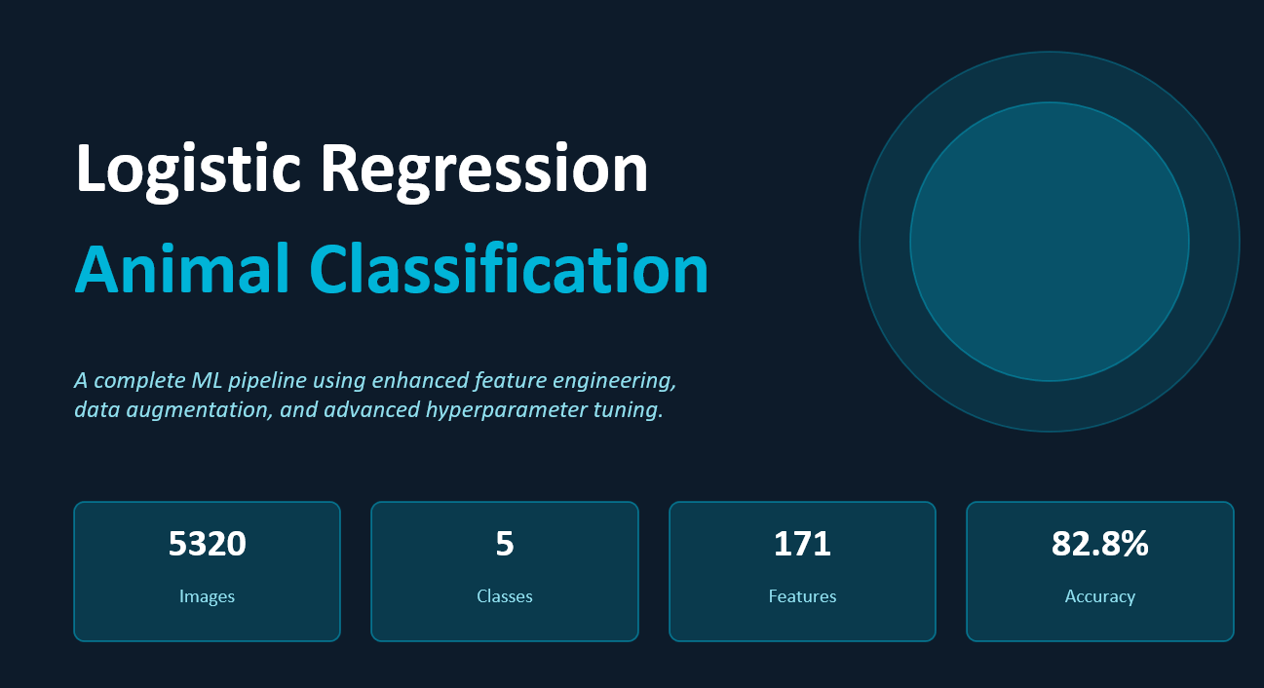
Logistic Regression

Slide 8
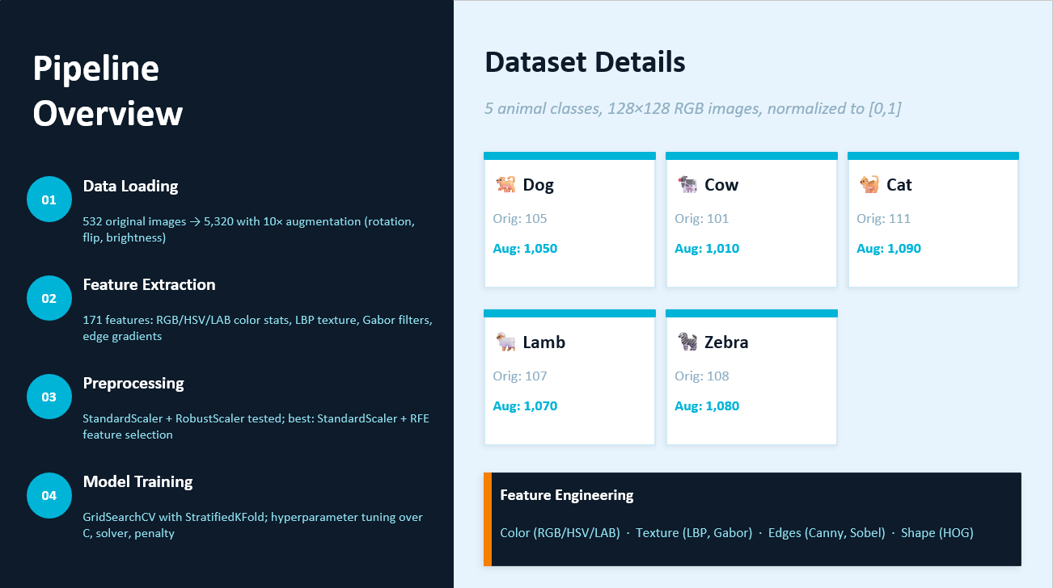
Pipeline Overview
Group: 1 Shahriar Swanon, Md. Abu Sufian Protik, Khandakar Atikur Ahsan, Md. Faiaz Bin Hayder

Slide 9
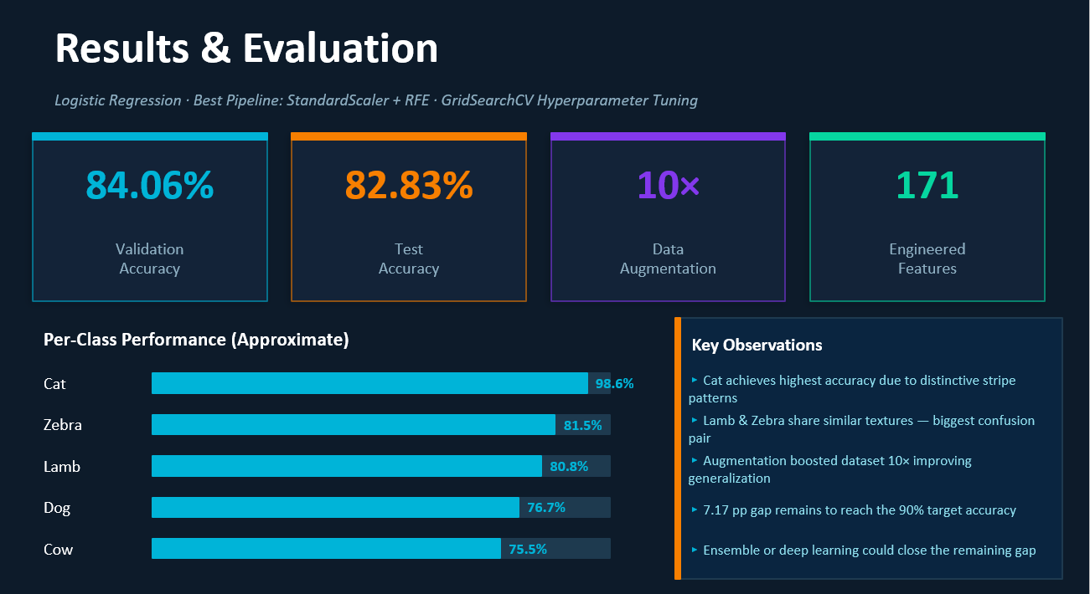
Group: 1 Shahriar Swanon, Md. Abu Sufian Protik, Khandakar Atikur Ahsan, Md. Faiaz Bin Hayder
Group: 1 Shahriar Swanon, Md. Abu Sufian Protik, Khandakar Atikur Ahsan, Md. Faiaz Bin Hayder

Slide 10
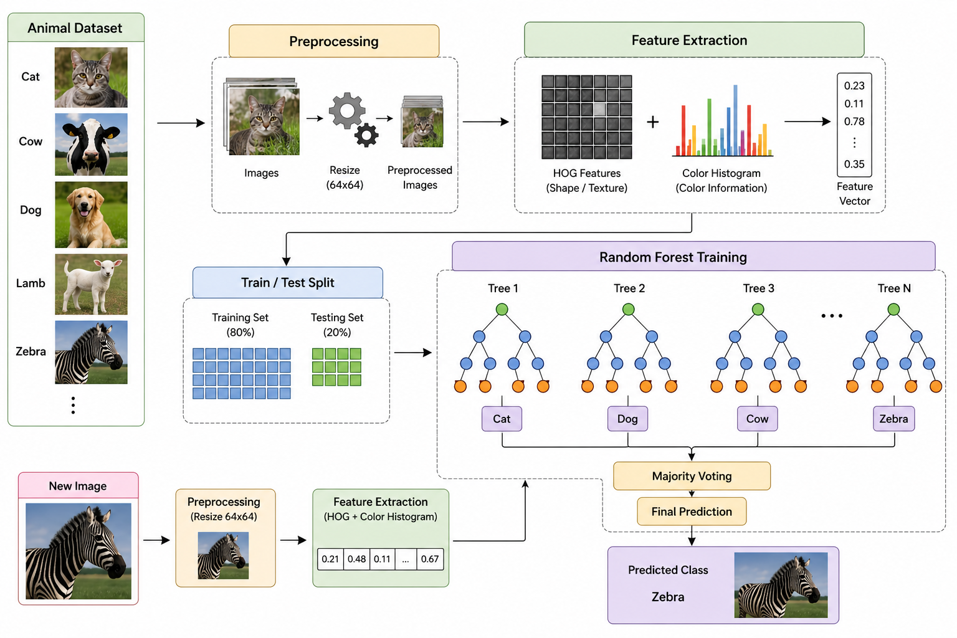
Random Forest

Slide 11
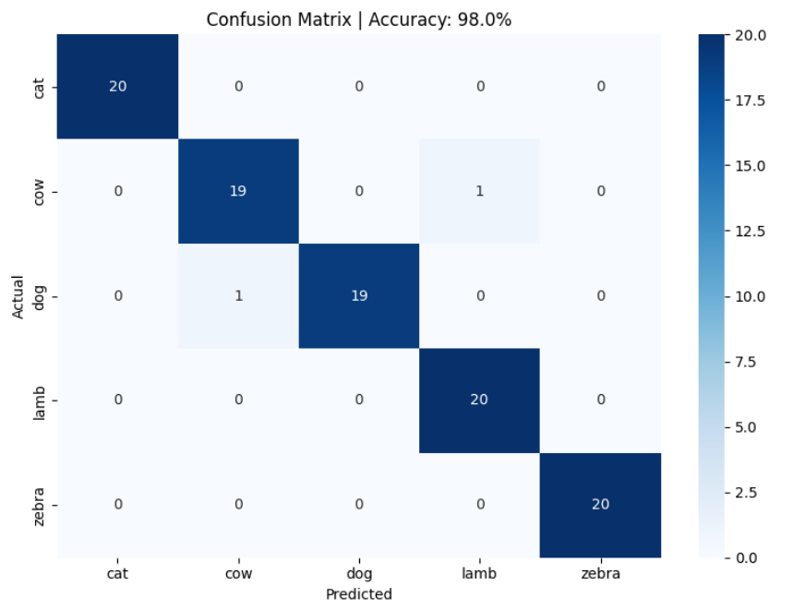
Results

Slide 12
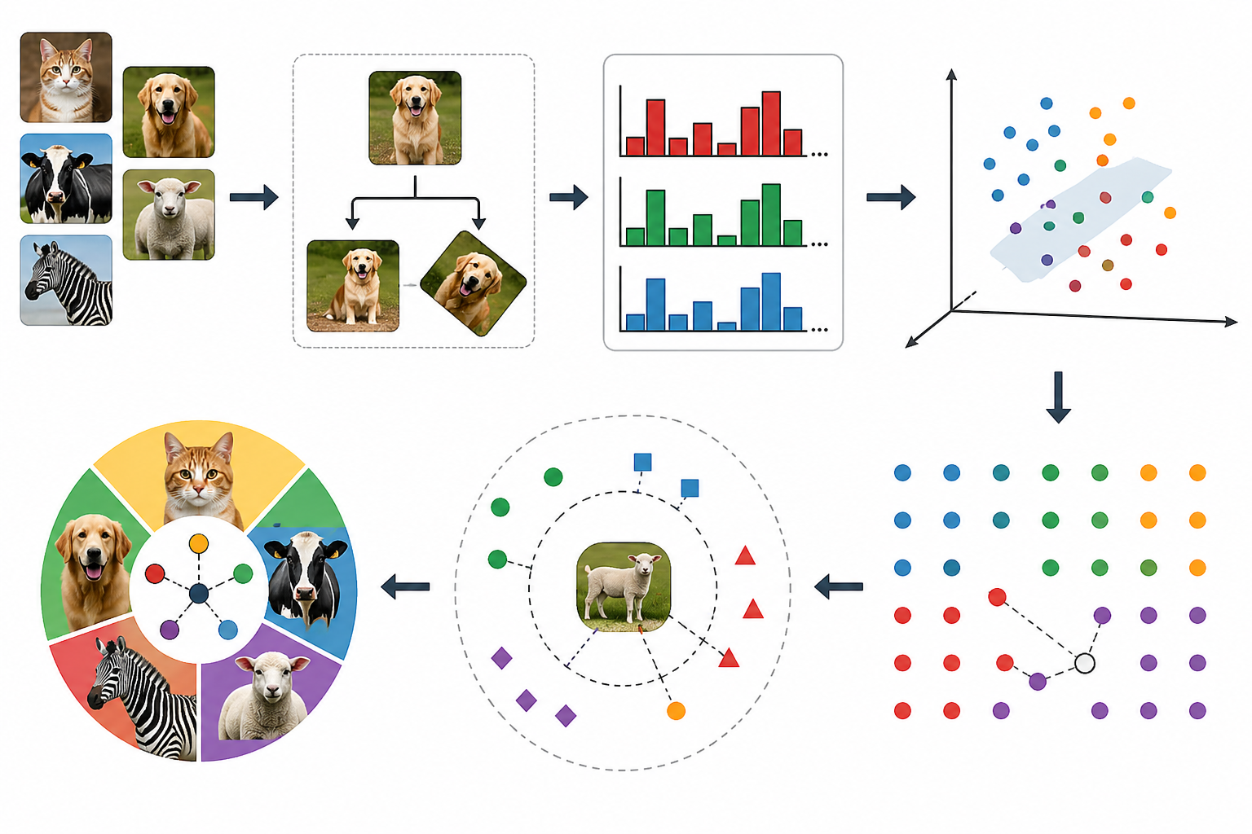
K-Nearest Neighbors (KNN)
Effective for multi-class image classification with extracted features
Non-parametric and works well with color histogram features
Chosen for its simplicity and interpretability
Used RGB color histograms (32 bins per channel → 96 features per image)
Features normalized via standardization
Applied PCA to reduce dimensionality while retaining 85% variance (reduced from 96 to 19 dimensions)

Slide 13
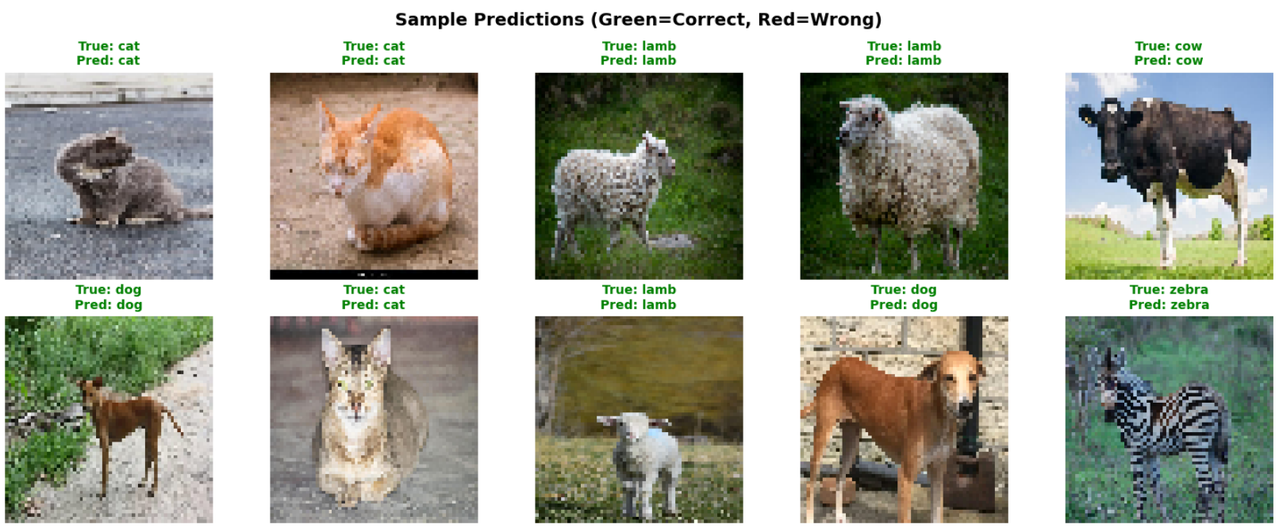
Results

Slide 14
Results
Overall accuracy 93.67%
Animal Name | Precision | Recall | F1
Cat | 96.43 | 94.74 | 95.58
Cow | 100.00 | 96.00 | 97.96
Dog | 91.80 | 87.00 | 89.60
Lamb | 91.80 | 96.55 | 94.12
Zebra | 90.54 | 94.37 | 92.41

Slide 15
Thank you

